Slide 1

Void Lensing in Cubic Galileon Gravity
Chen Su (SHAO, CAS)
Collaborators: Huanyuan Shan, Jiajun Zhang, Cheng Zhao, Jiaxi Yu, Linfeng Xiao, Qiao Wang, Xiangkun Liu and An Zhao
Based on: arXiv:2211.10187 (Accepted by ApJ)
5.17 @ HangZhou

Slide 2
Outline
Background
Theory: functions, void profile and calculation
Ray-tracing: method and results
Capability of testing gravity
Summary

Slide 3
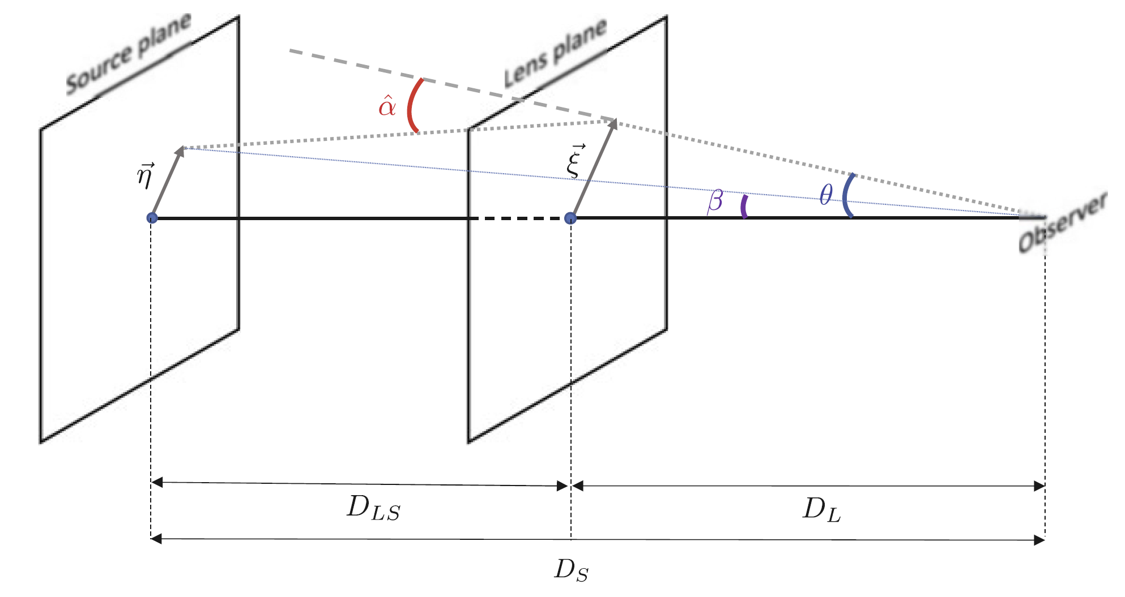
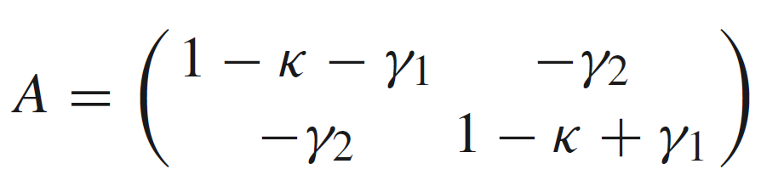
Background
Weak gravitational lensing
Notes:
In other word, in GR the Poisson equation tells us that the relations between the second derivative of Newtonian potential and the matter density is linear. When modified gravity models change the dark matter field, the form of Poisson equation do not change but the density term is changed; when changing the deflection angle, the Poisson equation is also changed.
These two aspects are always considered in previous works, especially theoretical works, since they obtain the lensing signals by intergrating the lensing potential directly. However, when someone would like to measure the lensing signal from simulations, people usually directly projecting the 3-D dark matter field along the LoS. This is valid in GR case but for some MG models, this method do not consider the change of the deflection angle, which may cause their results unbelievable. To obtain a more accurate lensing signals, one need to run a ray-tracing simulation to simulate a shear field, in which the change of the deflection angle can be introduced.

Slide 4
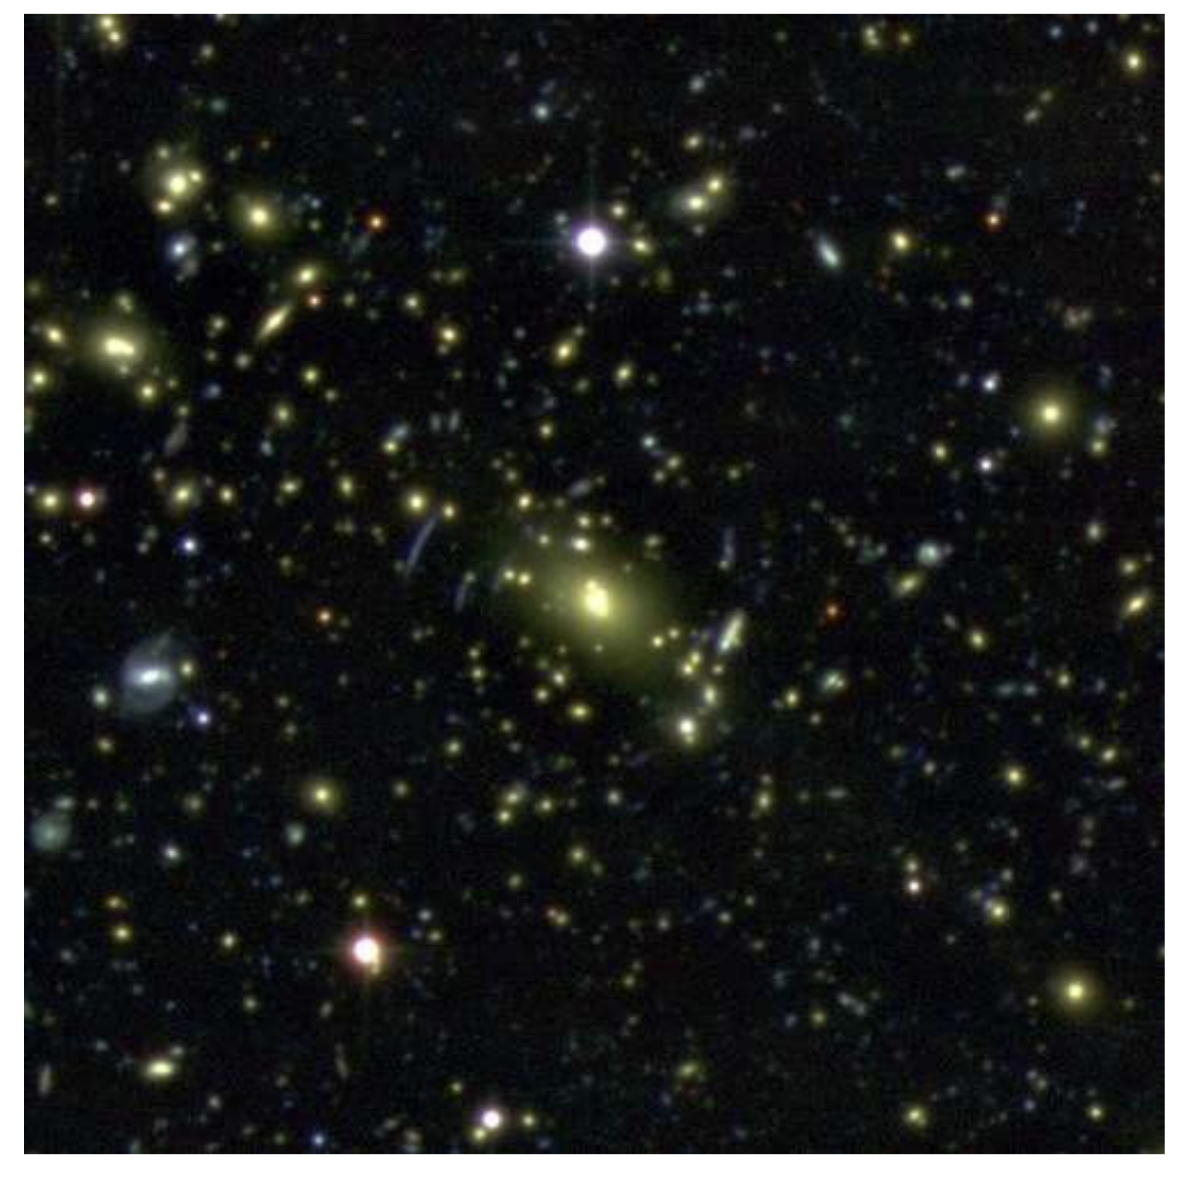
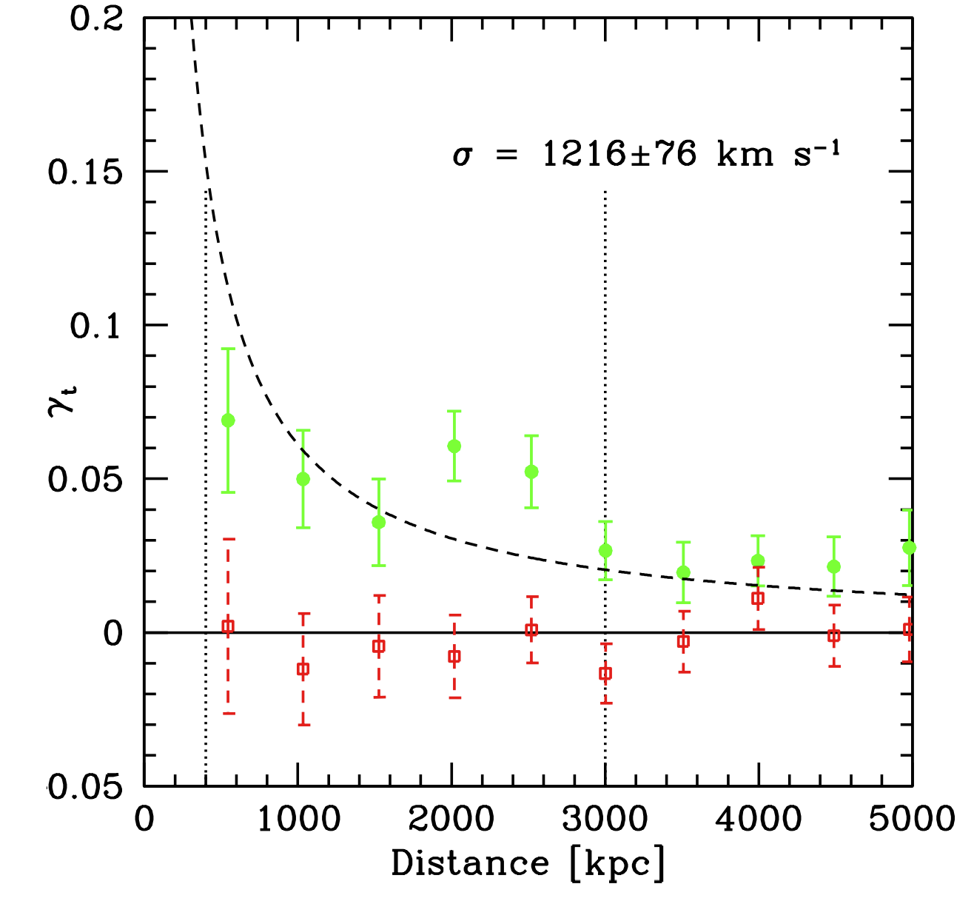
Background
From arxiv: 1304.0764

Slide 5
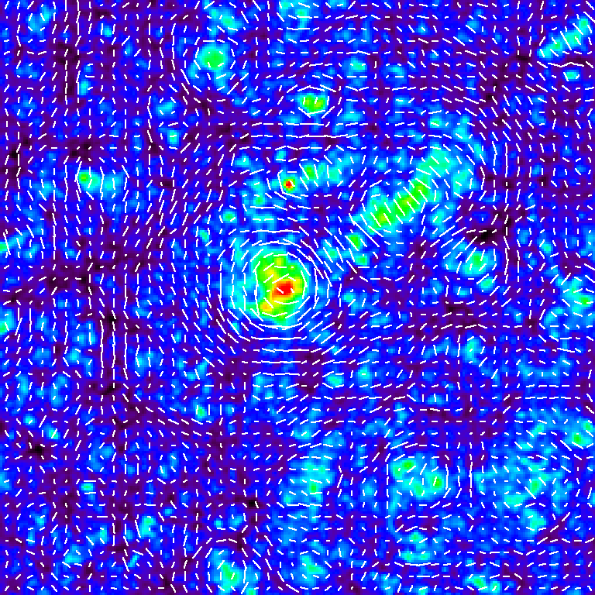
Background
Ray-tracing results.
Heatmap: dark matter distribution
Sticks: simulated galaxy shape
http://th.nao.ac.jp/MEMBER/hamanatk/HUBBLE_WGL/index.html

Slide 6
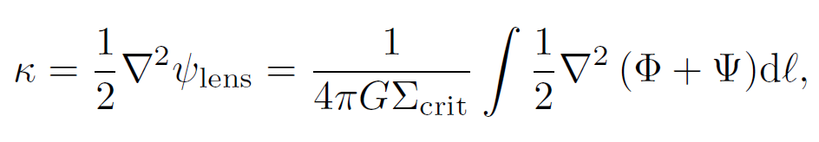
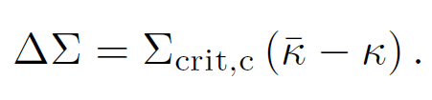
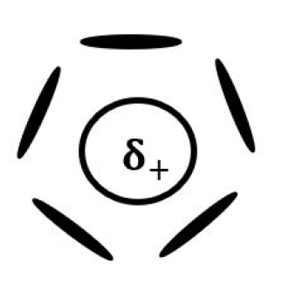
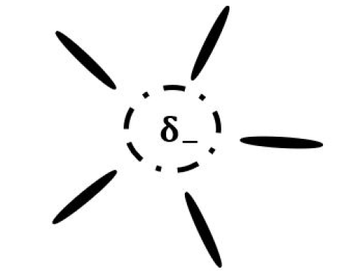
Background
Lensing signal as a probe to test gravity
Modified gravity (MG) and screen mechanism
Void lensing
left: galaxy-galaxy lensing.
right: void lensing.
(arxiv: 2108.03992)
Notes:
In other word, in GR the Poisson equation tells us that the relations between the second derivative of Newtonian potential and the matter density is linear. When modified gravity models change the dark matter field, the form of Poisson equation do not change but the density term is changed; when changing the deflection angle, the Poisson equation is also changed.
These two aspects are always considered in previous works, especially theoretical works, since they obtain the lensing signals by intergrating the lensing potential directly. However, when someone would like to measure the lensing signal from simulations, people usually directly projecting the 3-D dark matter field along the LoS. This is valid in GR case but for some MG models, this method do not consider the change of the deflection angle, which may cause their results unbelievable. To obtain a more accurate lensing signals, one need to run a ray-tracing simulation to simulate a shear field, in which the change of the deflection angle can be introduced.

Slide 7
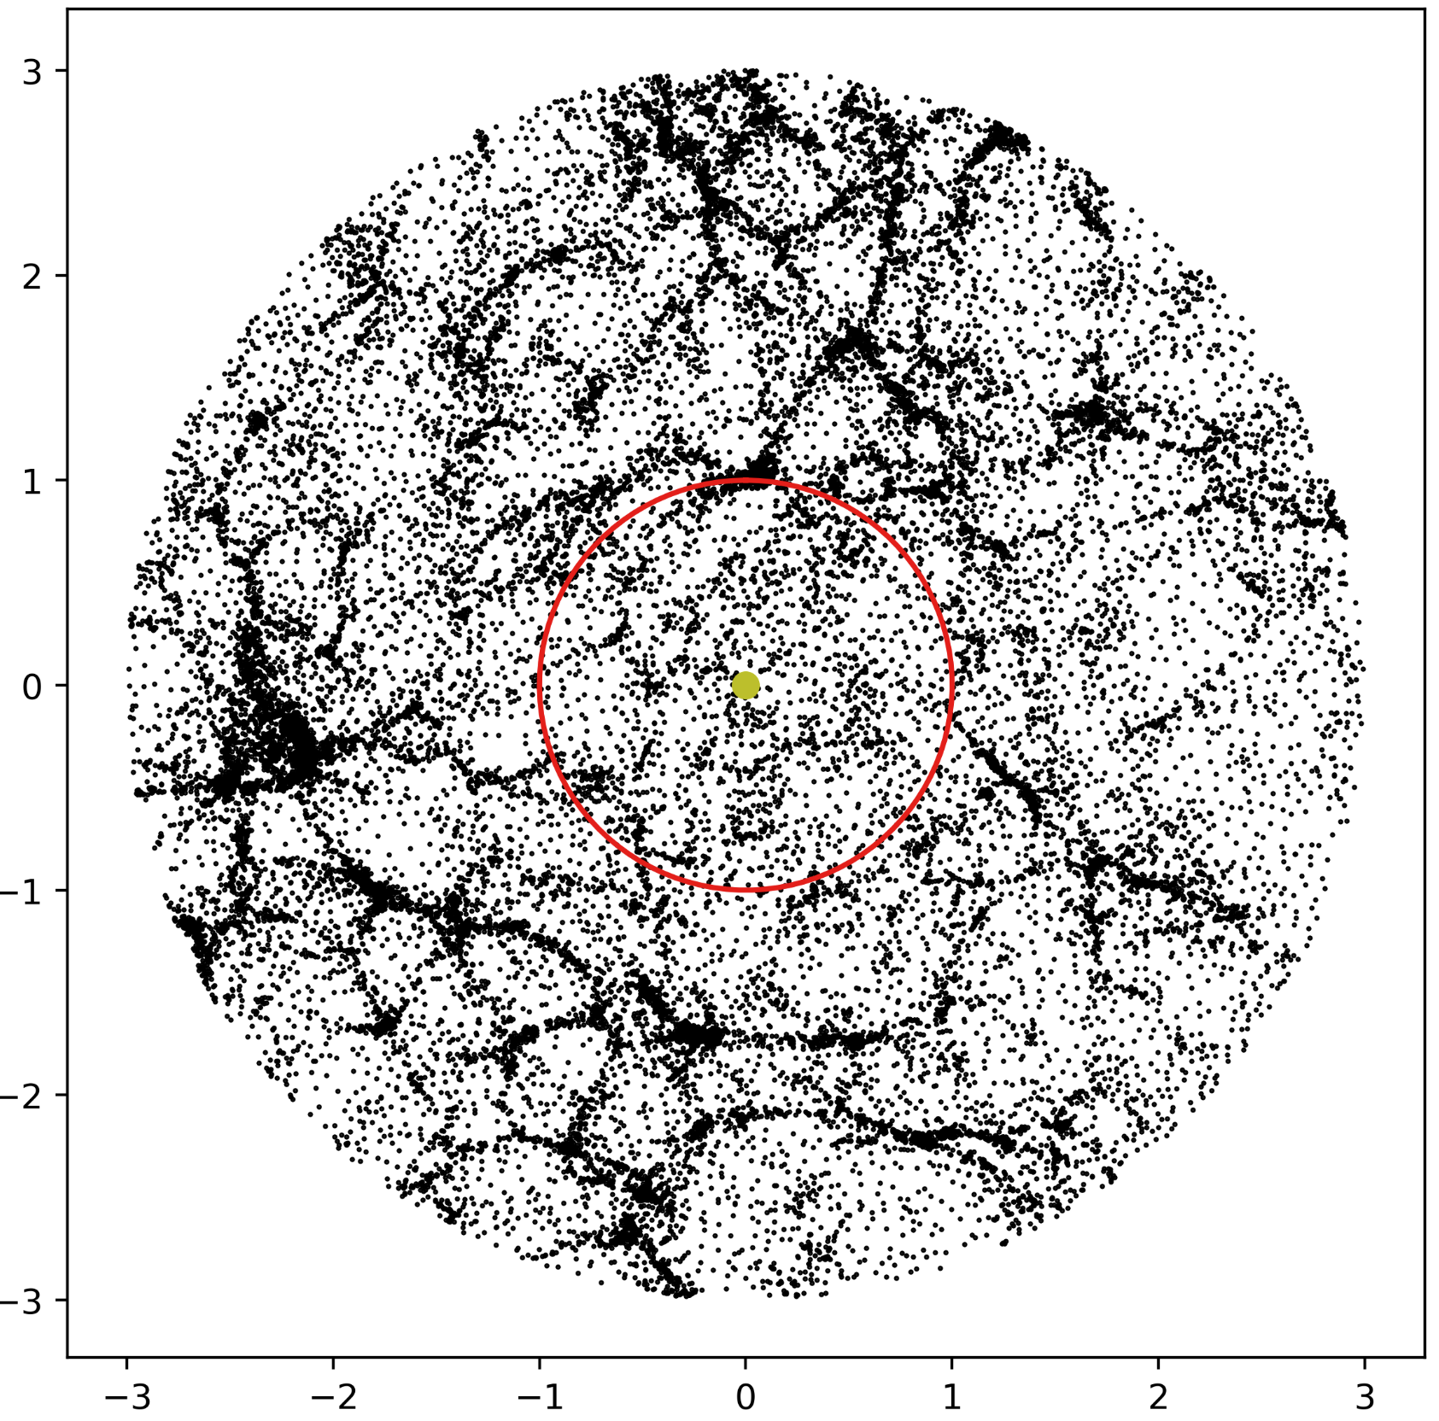
Background
In principle: ray-tracing to simulate background galaxy shape;
Alternative: projecting the 3D dark matter field in N-body simulation.
Notes:
In other word, in GR the Poisson equation tells us that the relations between the second derivative of Newtonian potential and the matter density is linear. When modified gravity models change the dark matter field, the form of Poisson equation do not change but the density term is changed; when changing the deflection angle, the Poisson equation is also changed.
These two aspects are always considered in previous works, especially theoretical works, since they obtain the lensing signals by intergrating the lensing potential directly. However, when someone would like to measure the lensing signal from simulations, people usually directly projecting the 3-D dark matter field along the LoS. This is valid in GR case but for some MG models, this method do not consider the change of the deflection angle, which may cause their results unbelievable. To obtain a more accurate lensing signals, one need to run a ray-tracing simulation to simulate a shear field, in which the change of the deflection angle can be introduced.

Slide 8
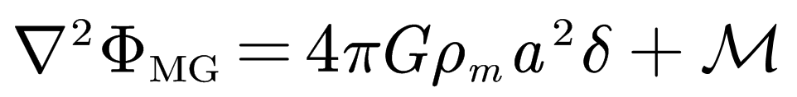
Background
Modified gravity models can influence lensing signals from two ways: 1) change the dark matter field; 2) change the deflection angle.
For MGs, it should be careful to obtain lensing signals in N-body simulation!
Notes:
In other word, in GR the Poisson equation tells us that the relations between the second derivative of Newtonian potential and the matter density is linear. When modified gravity models change the dark matter field, the form of Poisson equation do not change but the density term is changed; when changing the deflection angle, the Poisson equation is also changed.
These two aspects are always considered in previous works, especially theoretical works, since they obtain the lensing signals by intergrating the lensing potential directly. However, when someone would like to measure the lensing signal from simulations, people usually directly projecting the 3-D dark matter field along the LoS. This is valid in GR case but for some MG models, this method do not consider the change of the deflection angle, which may cause their results unbelievable. To obtain a more accurate lensing signals, one need to run a ray-tracing simulation to simulate a shear field, in which the change of the deflection angle can be introduced.

Slide 9
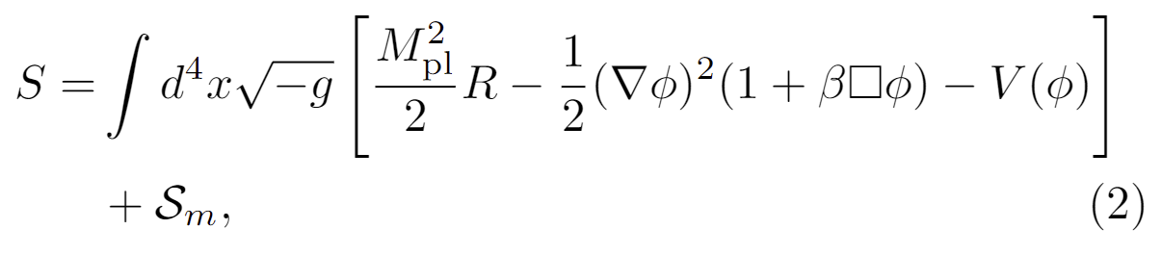
Background
Our work: using ray-tracing simulation, choosing Cubic Galileon (CG) gravity as an example, to study void lensing effect in simulation.
The Lagrangian of CG gravity:
Notes:
In other word, in GR the Poisson equation tells us that the relations between the second derivative of Newtonian potential and the matter density is linear. When modified gravity models change the dark matter field, the form of Poisson equation do not change but the density term is changed; when changing the deflection angle, the Poisson equation is also changed.
These two aspects are always considered in previous works, especially theoretical works, since they obtain the lensing signals by intergrating the lensing potential directly. However, when someone would like to measure the lensing signal from simulations, people usually directly projecting the 3-D dark matter field along the LoS. This is valid in GR case but for some MG models, this method do not consider the change of the deflection angle, which may cause their results unbelievable. To obtain a more accurate lensing signals, one need to run a ray-tracing simulation to simulate a shear field, in which the change of the deflection angle can be introduced.

Slide 10
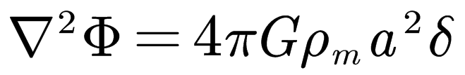
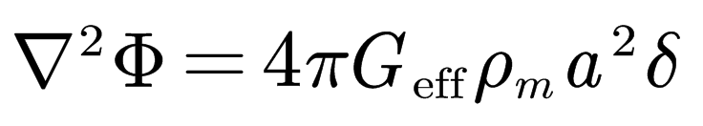
Theory: Functions
Model:
Only consider changes of dark matter field:
Only consider changes of deflection angle:
The only ingredient needed is the void density profile.

Slide 11
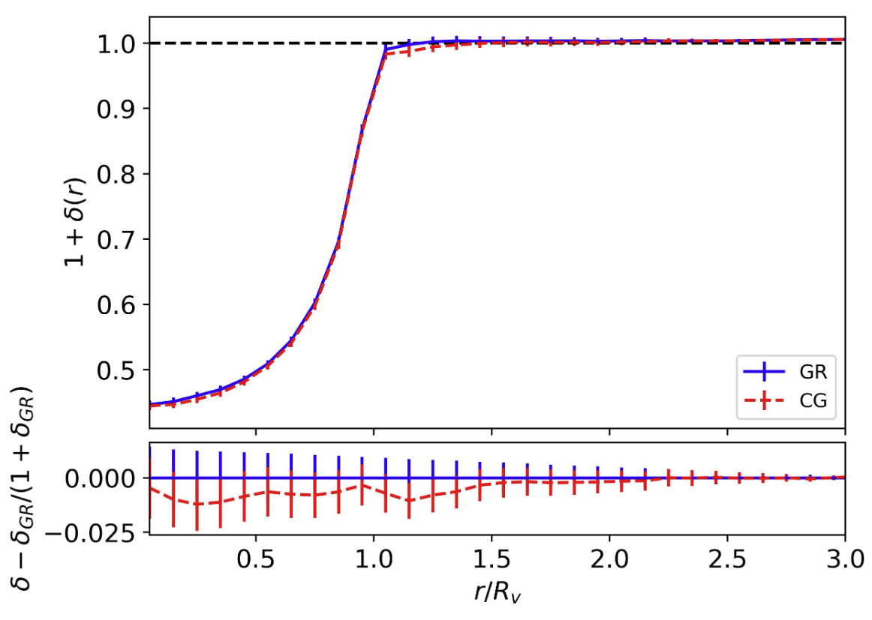
Theory: Void profile
N-body simulation: N=512³, box=400 h⁻¹Mpc. (arxiv: 2004.12659)
Voids: DIVE void finder. (arxiv: 1511.04299)

Slide 12
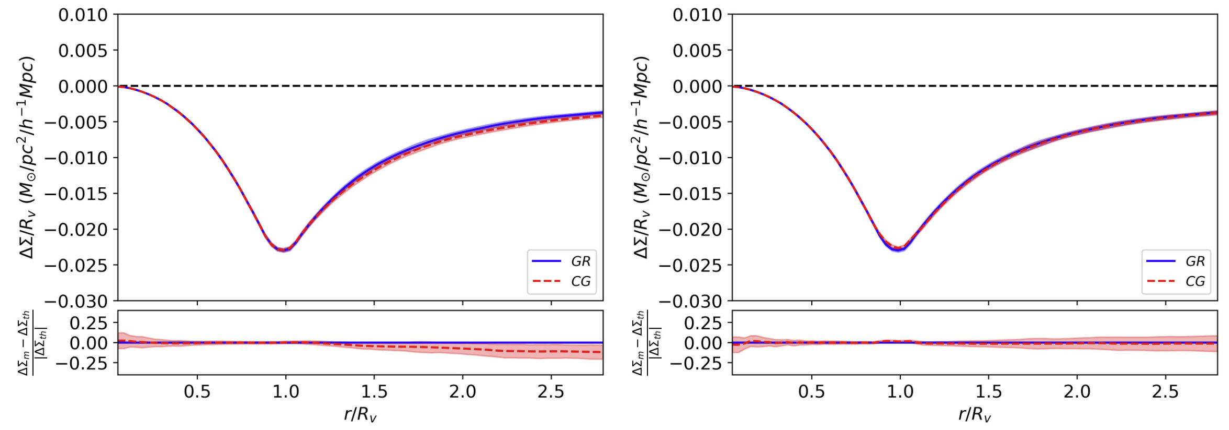
Theory: Calculations
Left: only change the dark matter (DM) field; right: only change the deflection angle.
Conclusion: Influences on deflection angle is negligible.
Notes:
Simultaneously considering these two effects is not much difficult. However, determining which one is dominant can still simplify our analysis. We consider this problem in two viewpoints, one is from theoretical calculations and the other from simulations.
When considering the change of the dark matter field, we find a small discrepency between the two models; and for the case that we only consider the change of the deflection angle, the predictions are almost the same.

Slide 13
Ray-tracing: Method
Ray-tracing: from z=0 to z=0.75.
Generate lightcone → Calculate deflection angle → Shear map.
Cross-correlating void position and tangential shear to measure lensing signal.

Slide 14
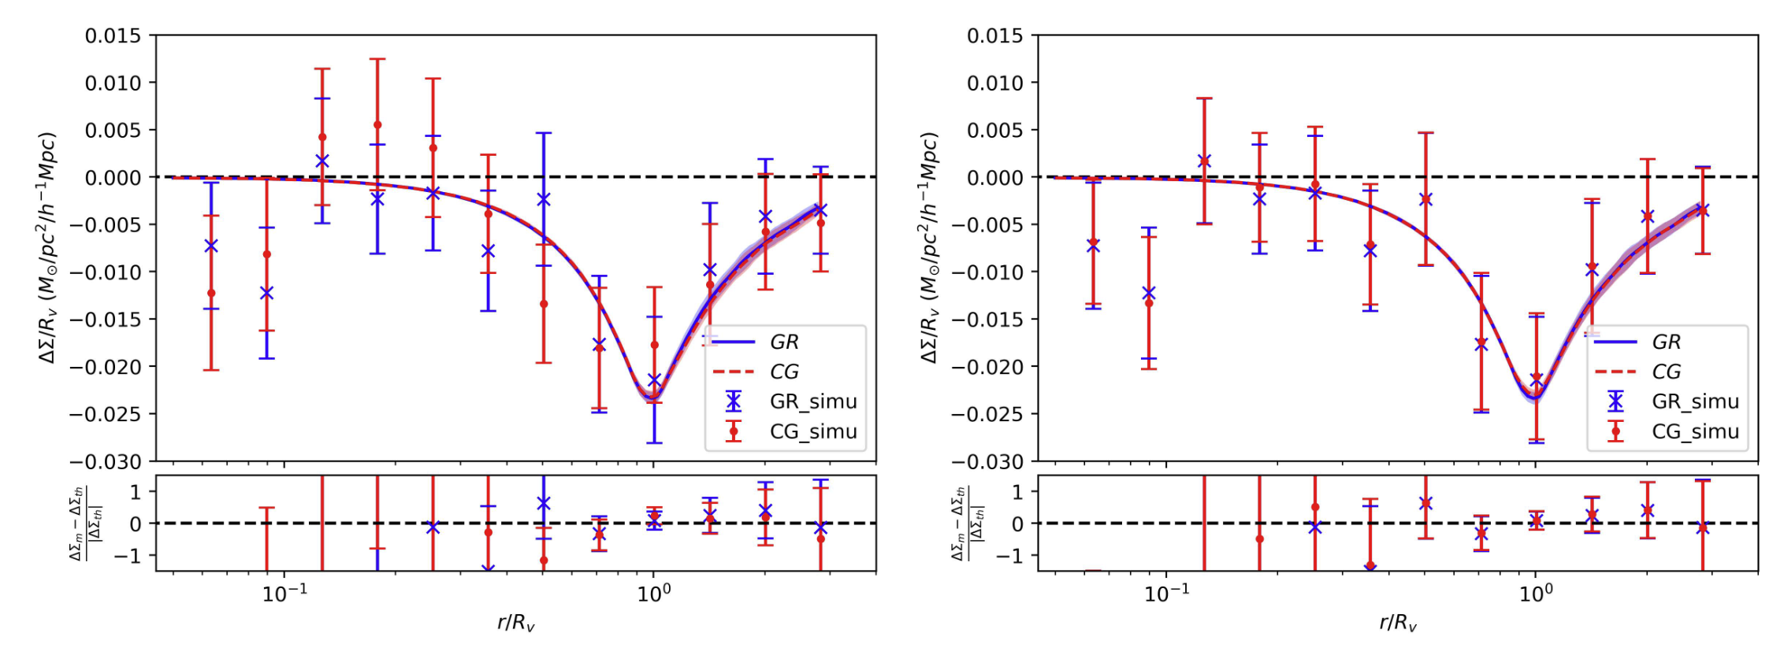
Ray-tracing: Results
Left: only change the DM field; right: only change the deflection angle (without shape noise).
Conclusion: influences on deflection angle is negligible.
Notes:
Since the theoretical model is an ideal case to some extent, we would like to know if this conclusion is still valid in the simulation which, in principle, should be more realistic.
Here are our results. From the left figure, when we only consider the change of the dark matter field, the differences between the two models do exist, but statistically, the discrepancies are not significant. For the other case that only the change of the deflection angle is considered, there are no significant discrepancy between two models.

Slide 15
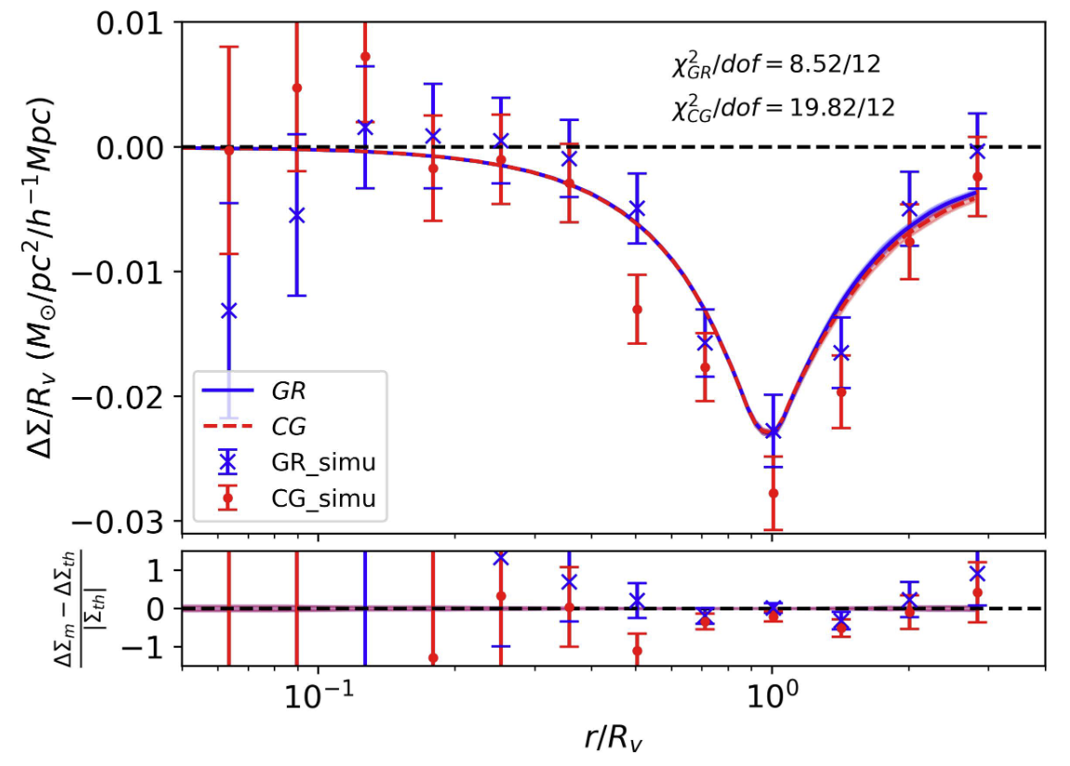

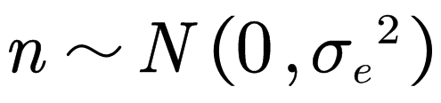
Capability of testing gravity
Area ~ 1395 deg², n_{gal}= 10 arcmin⁻².
Adding shape noise
with σ_{e}=0.3.
Conclusion: void lensing cannot distinguish GR and CG.
Notes:
To analysis the capability of distinguishing two gravity models, we regard the simulation data as the observed signal utilized for a fitting of theoretical predictions, and compare the chi2 of the two models. First we assume the observed signals are consistent with those in GR simulation, and then calculate the chi2 of the two models. Results are shown in the first line of the table. Quantities in the parenthesis is the corresponding p-value, representing the rejection rate from the simulation results. The same analysis is repeated under the assumption that the CG simulation mimic the observations. The second line in the table shows the chi2 value and the corresponding p-values.

Slide 16

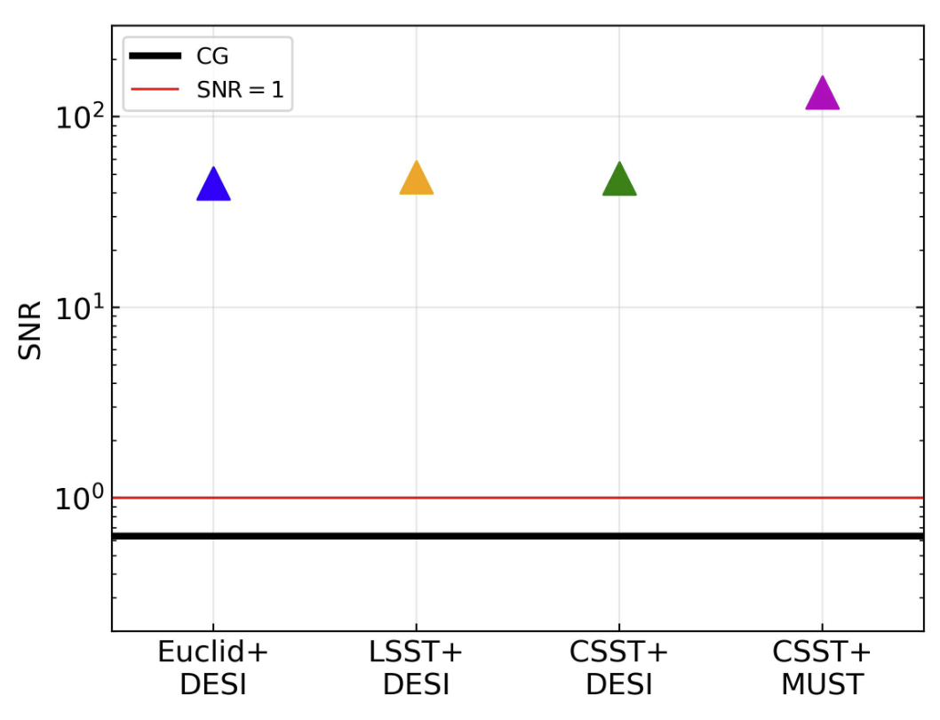
Capability of testing gravity
Forecast
 | CG | Euclid | LSST | CSST
Area | 1,395 | 15,000 | 20,000 | 17,500
n_{gal} | 10 | 30 | 26 | 28.89
 | CG | DESI | MUST
n_{void} | 0.012 | 1.0 | 8.0

Slide 17
Summary
Void lensing is a probe to test gravity;
We present a pipeline to measure the lensing signals from simulation, which can be utilized in Modified Gravity studies;
In CG gravity, the effects due to the change of the deflection angle is negligible;
Next generation survey is possible to distinguish CG from GR.

Slide 18
Thanks!

Slide 19
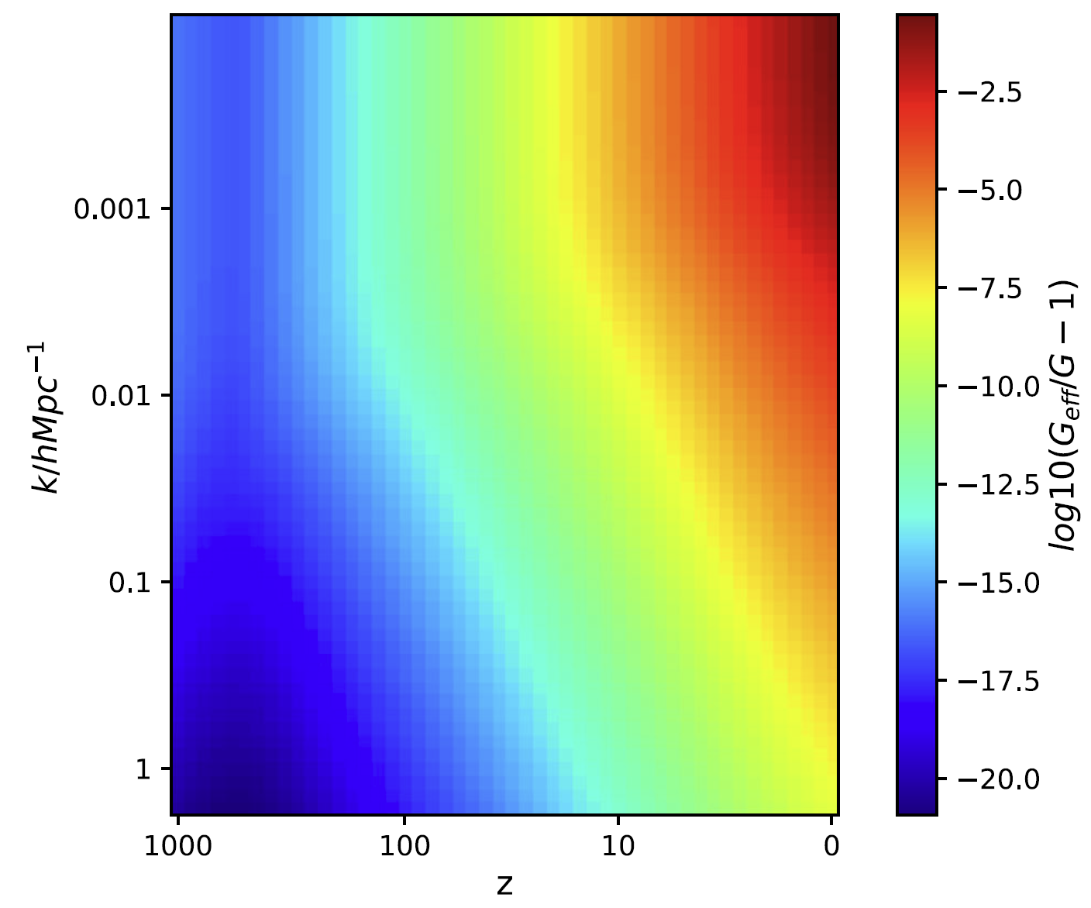
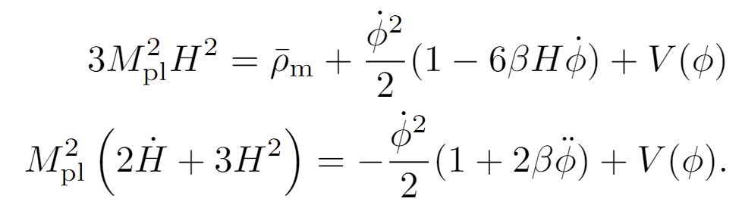
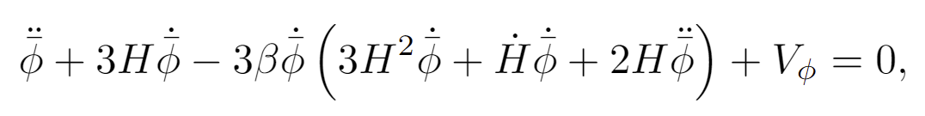
Cubic Galileon Gravity
Zhang et al. (2020)

Slide 20
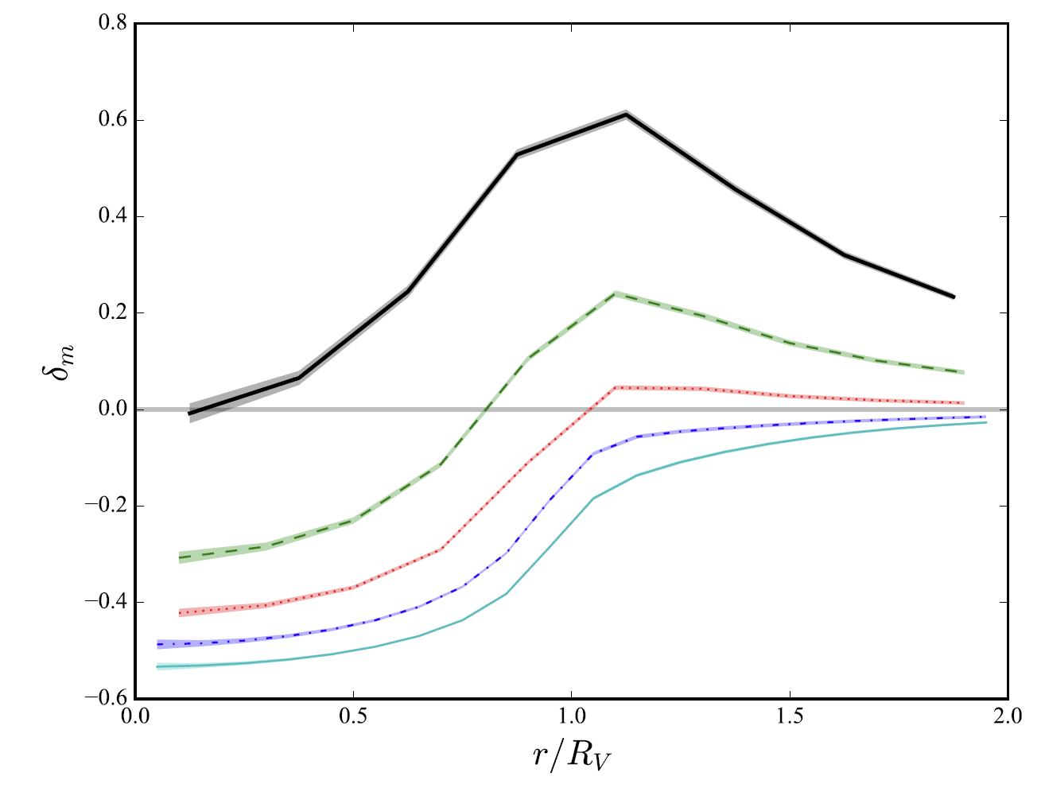
Void finder
DIVE: Delaunay TrIangulation Void finder

Slide 21
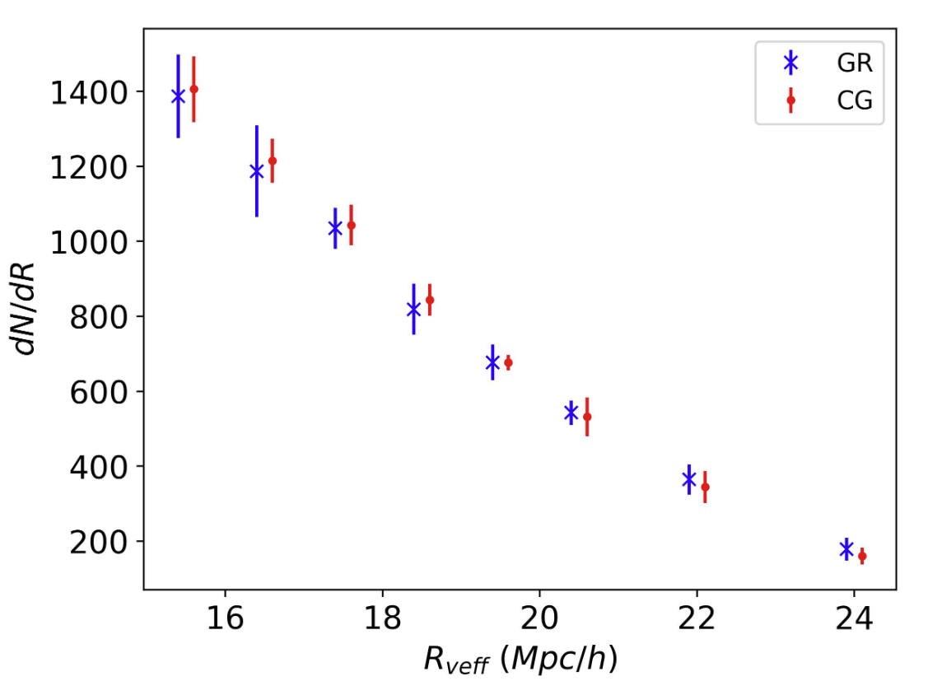
Ray-tracing: Void catalog
N-body simulation again
Void finder: DIVE (Zhao et al. 2016) GR: 6732 CG: 6724

Slide 22
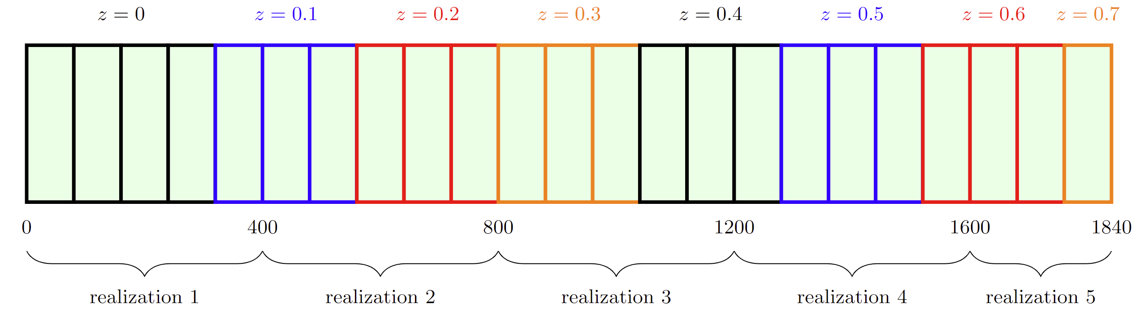
N-body simulation and ray-tracing
Lightcone

Slide 23
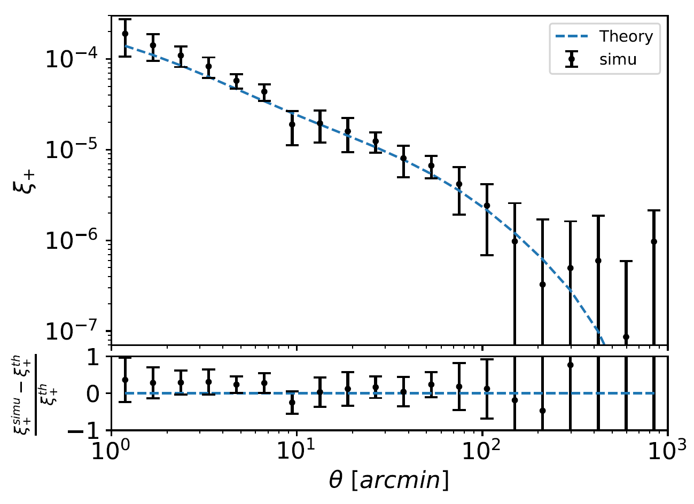
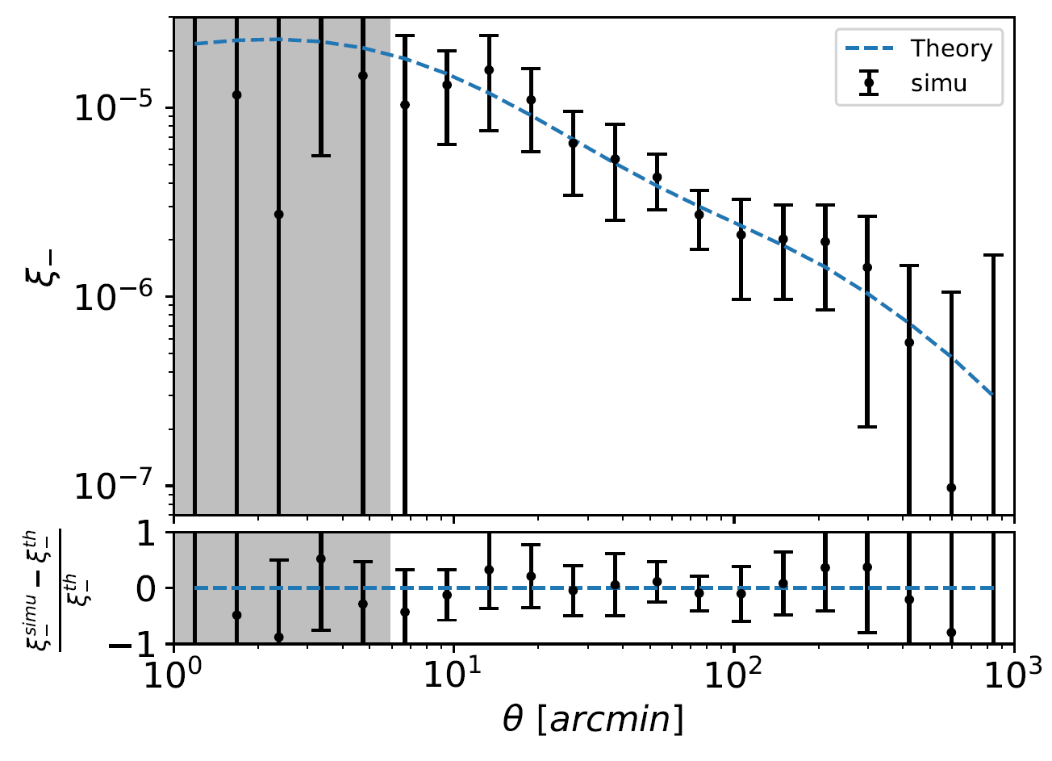
Test of ray-tracing results
Test for ray-tracing method: ΛCDM case

